Slide 1

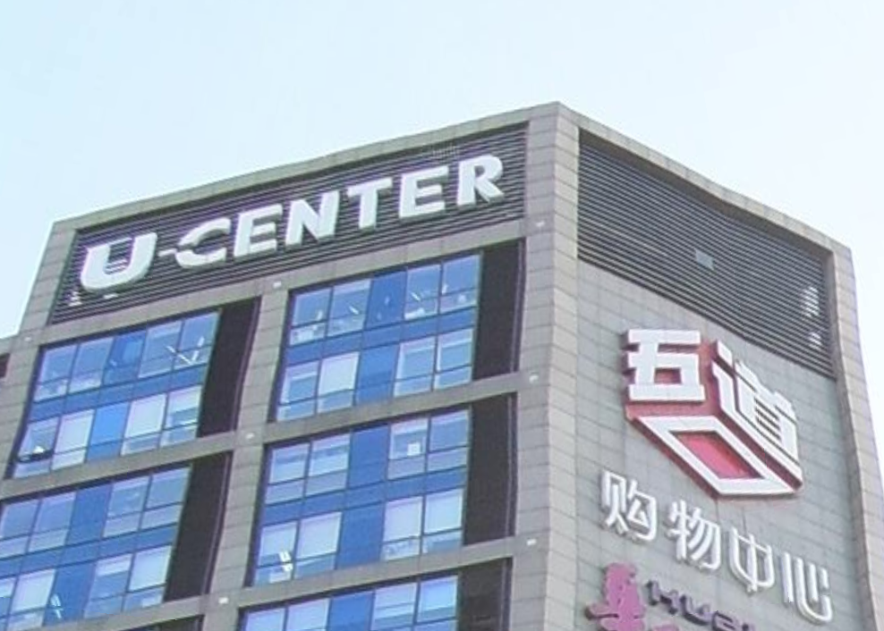
Path Aggregation for Instance Segmentation & Object Detection
Team UCenter
Shu Liu¹, Lu Qi¹, Haifang Qin², Jianping Shi², Jiaya Jia¹
¹The Chinese University of Hong Kong, ²Sensetime

Slide 2
Team Members
Shu Liu
Lu Qi
Haifang Qin
Jianping Shi
Jiaya Jia

Slide 3
Summary
Improvements
Instance Segmentation
9.1% absolute and 24% relative improvement
Object Detection
9.5% absolute and 22% relative improvement
Y. Li, H. Qi, J. Dai, X. Ji, and Y. Wei. Fully convolutional instance-aware semantic segmentation. CVPR, 2017.
J. Dai, K. He, and J. Sun. Instance-aware semantic segmentation via multi-task network cascades. CVPR, 2016.
J. Huang, V. Rathod, C. Sun, M. Zhu, A. Korattikara, A. Fathi, I. Fischer, Z. Wojna, Y. Song, S. Guadarrama, K. Murphy. Speed/accuracy trade-offs for modern convolutional object detectors. CVPR, 2017
K. He, G. Gkioxari, P. Dollár, and R. Girshick. Mask R-CNN. ICCV, 2017.

Slide 4
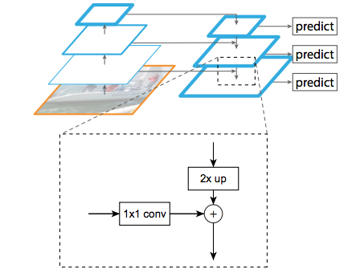
Baseline
FPN
T. Lin, P. Dollár, R. Girshick, K. He, B. Hariharan, and S. Belongie. Feature Pyramid Networks for Object Detection. CVPR, 2017.
Figure from corresponding paper.

Slide 5
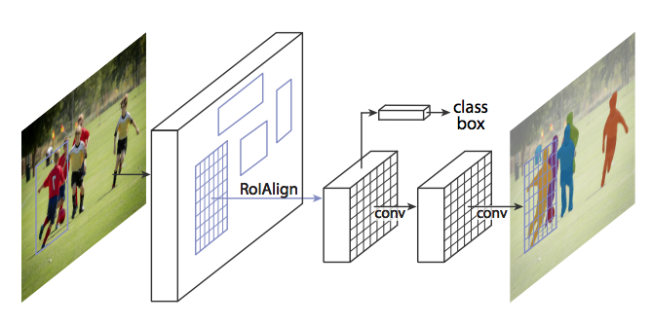
Baseline
Mask RCNN
K. He, G. Gkioxari, P. Dollár, and R. Girshick. Mask R-CNN. ICCV, 2017.
Figure from corresponding paper.

Slide 6
What about more flexible information flow?

Slide 7
Adaptive Feature Pooling
ROIs
predict
predict
predict
predict
Image

Slide 8
Adaptive Feature Pooling
Benefits
Larger Object
Gather information from lower layers with fine details
Smaller Object
Gather information from higher layers with larger receptive field
Useful information in all levels within proposal contribute to final predictions
S. Bell, C. L. Zitnick, K. Bala, and R. B. Girshick. Inside-outside net: Detecting objects in context with skip pooling and recurrent neural networks. In CVPR, 2016.
S. Zagoruyko, A. Lerer, T. Lin, P. H. O. Pinheiro, S. Gross, S.Chintala, and P.Dolla ́r. A multipath network for object detection. In BMVC, 2016.

Slide 9
Adaptive Feature Pooling

Slide 10
Adaptive Feature Pooling
Error Type | Loc | Sim | Oth | BG | FN
Difference | +0.3 | +0.1 | -0.1 | -1.1 | +0.1

Slide 11
Bottom-up Feature Augmentation
Common sense:
Features in higher layers are important for high-level understanding.
New findings:
Features in lower layers also play important role for instance recognition.
T. Kong, A. Yao, Y. Chen, and F. Sun. Hypernet: Towards accurate region proposal generation and joint object detection. In CVPR, 2016.
J. Long, E. Shelhamer, and T. Darrell. Fully convolutional networks for semantic segmentation. In CVPR, 2015.
W. Liu, D. Anguelov, D. Erhan, C. Szegedy, S. E. Reed, C. Fu, and A. C. Berg. SSD: single shot multibox detector. In ECCV, 2016.
Z. Cai, Q. Fan, R. S. Feris, and N. Vasconcelos. A unified multi-scale deep convolutional neural network for fast object detection. In ECCV, 2016.
B. Hariharan, P. Arbela ́ez, R. Girshick, and J. Malik. Hypercolumns for object segmentation and fine-grained localization. In CVPR, 2015.
H. Noh, S. Hong, and B. Han. Learning deconvolution network for semantic segmentation. In ICCV, 2015.

Slide 12
Bottom-up Feature Augmentation
predict
predict
predict
Image

Slide 13
Bottom-up Feature Augmentation
Error Type | Loc | Sim | Oth | BG | FN
Difference | 0 | 0 | +0.1 | -0.6 | -0.3

Slide 14
FC Augmentation for Mask Prediction
FCN
Local receptive field
Parameters shared at different spatial locations
Fully connected
Location sensitive
Predictions made on global information
What about fusing them?
J. Dai, K. He, and J. Sun. Instance-aware semantic segmentation via multi-task network cascades. CVPR, 2016.
P. H. O. Pinheiro, R. Collobert, and P. Dolla ́r. Learning to segment object candidates. In NIPS, 2015. P. H. O. Pinheiro, T. Lin, R. Collobert, and P. Dolla ́r. Learning to refine object segments. In ECCV, 2016.

Slide 15
FC Augmentation for Mask Prediction
ROI
conv1
conv2
conv3
conv4
deconv
mask
mask
fc
reshape
conv4_fc
conv5_fc

Slide 16
FC Augmentation for Mask Prediction
Error Type | Loc | Sim | Oth | BG | FN
Difference | -0.3 | -0.1 | 0 | -0.3 | +0.1

Slide 17
Summary
Backbone
Bottom-up path
ROI
Pool feature from all levels
Mask prediction
FC augmentation
Just modify proto.

Slide 18
Other Improvements
Multi-scale training & Synchronized BN
Heavier head
Deformable Convolutional Network (DCN)
Multi-scale and flip testing
Mask voting
Ensemble

Slide 19
Roadmap

Slide 20
Baseline
Our re-implementations (Resnet-50)
name | Mask AP | Bbox AP | AR@1000
Mask R-CNN | 33.6 | - | -
Mask R-CNN re-implementation | 33.4 | 36.4 (multi-task) | -
FPN | - | 33.9 | -
FPN re-implementation | - | 35 | -
FPN-RPN | - | - | 56.4
FPN-RPN re-implementation | - | - | 58.4
T. Lin, P. Dollár, R. Girshick, K. He, B. Hariharan, and S. Belongie. Feature Pyramid Networks for Object Detection. CVPR, 2017.
K. He, G. Gkioxari, P. Dollár, and R. Girshick. Mask R-CNN. ICCV, 2017.

Slide 21
MS-training & BN
MS-training
Shorter edge: [400 : 200 : 1400]
Longer edge: 1400
Multi-GPU Synchronized BN
Parameters not fixed
name | Mask AP | Bbox (M) AP | Bbox AP | Improvement
Baseline | 33.4 | 36.4 | 35
+ms training | 35.3 | 38.2 | 35 | +1.9/+1.8/+0
+BN | 35.7 | 38.9 | 37.1 | +0.4/+0.7/+2.1
H. Zhao, J. Shi, X. Qi, X. Wang, J. Jia.. Pyramid Scene Parsing Network. CVPR, 2016.

Slide 22
Adaptive Feature Pooling
Results
Detailed Improvement
name | Mask AP | Bbox (M) AP | Bbox AP | Improvement
Baseline | 33.4 | 36.4 | 35 | -
+ms training | 35.3 | 38.2 | 35 | +1.9/+1.8/+0
+BN | 35.7 | 38.9 | 37.1 | +0.4/+0.7/+2.1
+ada. feat. pooling | 36.3 | 39.6 | 37.9 | +0.6/+0.7/+0.8
 | AP | AP 0.5 | AP 0.75 | AP S | AP M | AP L
Mask | +0.6 | +0.7 | +0.9 | +0.4 | +0.7 | +0.7
Bbox | +0.8 | +1.1 | +0.7 | +1.2 | +0.6 | +1.5

Slide 23
Adaptive Feature Pooling
Where to place it?
P4
P4
P5
P5
ROI
fc1
fc2
ROI
fc1
fc2
before fc1
after fc1

Slide 24
Adaptive Feature Pooling
Ablations
Location
Operation
name | Mask AP | Bbox (M) AP | Bbox AP
Before fc1 | 35.7 | 38.8 | 37.3
After fc1 | 36.3 | 39.6 | 37.9
name | Mask AP | Bbox (M) AP | Bbox AP
SUM | 36.2 | 39.5 | 38
MAX | 36.3 | 39.6 | 37.9

Slide 25
Bottom-up Feature Augmentation
Results:
Detailed Improvement
name | Mask AP | Bbox (M) AP | Bbox AP | Improvement
Baseline | 33.4 | 36.4 | 35 | -
+ms training | 35.3 | 38.2 | 35 | +1.9/+1.8/+0
+BN | 35.7 | 38.9 | 37.1 | +0.4/+0.7/+2.1
+ada. feat. pooling | 36.3 | 39.6 | 37.9 | +0.6/+0.7/+0.8
+feat. augmentation | 36.9 | 40.6 | 39 | +0.6/+1.0/+1.1
 | AP | AP 0.5 | AP 0.75 | AP S | AP M | AP L
Mask | +0.6 | +0.5 | +0.8 | +0.6 | +0.6 | +0.8
Bbox | +1.1 | +0.5 | +1.4 | +0.3 | +1.1 | +0.9

Slide 26
FC Augmentation for Mask Prediction
Results:
Detailed Improvement
name | Mask AP | Bbox (M) AP | Bbox AP | Improvement
Baseline | 33.4 | 36.4 | 35 | -
+ms training | 35.3 | 38.2 | 35 | +1.9/+1.8/+0
+BN | 35.7 | 38.9 | 37.1 | +0.4/+0.7/+2.1
+ada. feat. pooling | 36.3 | 39.6 | 37.9 | +0.6/+0.7/+0.8
+feat. augmentation | 36.9 | 40.6 | 39 | +0.6/+1.0/+1.1
+FC augmentation | 37.6 | - | - | +0.7/-/-
 | AP | AP 0.5 | AP 0.75 | AP S | AP M | AP L
Mask | +0.7 | +0.6 | +0.9 | +0.7 | +0.6 | +0.6

Slide 27
Heavier Head
4 convolution layers and 1 fully-connected layer
Bbox
regression
ROI
conv1
conv2
conv3
conv4
class
T. Lin, P. Goyal, R. Girshick, K. He, Piotr Dollár. Focal Loss for Dense Object Detection. ICCV, 2017.
S. Ren, K. He, R. Girshick, X. Zhang, J. Sun. Object Detection Networks on Convolutional Feature Maps. TPAMI.

Slide 28
Heavier Head
Results:
name | Mask AP | Bbox (M) AP | Bbox AP | Improvement
Baseline | 33.4 | 36.4 | 35 | -
+ms training | 35.3 | 38.2 | 35 | +1.9/+1.8/+0
+BN | 35.7 | 38.9 | 37.1 | +0.4/+0.7/+2.1
+ada. feat. pooling | 36.3 | 39.6 | 37.9 | +0.6/+0.7/+0.8
+feat. augmentation | 36.9 | 40.6 | 39 | +0.6/+1.0/+1.1
+FC augmentation | 37.6 | 40.6 | - | +0.7/0/-
+heavier head | 37.8 | 42.1 | 39.2 | +0.2/+1.5/+0.2

Slide 29
PANet Improvement
Results:
name | Mask AP | Bbox (M) AP | Bbox AP | Improvement
Baseline | 33.4 | 36.4 | 35 | -
PANet | 37.8 | 42.1 | 39.2 | +4.4/+5.7/+4.2

Slide 30
Testing Tricks & DCN
Multi-scale testing
Shorter edge: 600, 800, 1000, 1200
Longer edge: 1400
Horizontal flip
Mask voting
Deformable Convolutional Network (DCN)
Simply follow paper
No other hackings
J. Dai, H. Qi, Y. Xiong, Y. Li, G. Zhang, H. Hu, and Y. Wei. Deformable Convolutional Networks. ICCV, 2017

Slide 31
Testing Tricks & DCN
name | Mask AP | Bbox (M) AP | Bbox AP | Improvement
Baseline | 33.4 | 36.4 | 35 | -
PANet | 37.8 | 42.1 | 39.2 | +4.4/+5.7/+4.2
+DCN | 39.1 | 43.7 | 42.6 | +1.3/+1.6/+3.4
+testing tricks | 41.6 | 44.2 | 43.6 | +2.5/+0.5/+1

Slide 32
Error Analysis
Error Type | Loc | Sim | Oth | BG | FN
Difference | -1.2 | -0.3 | -0.3 | -2 | -1.9

Slide 33
Best Single Model
Resnet-50
Mask AP: 41.6 vs Champion 2016: 37.6 (6 Resnet-101)
Bbox AP: 45.8 vs Champion 2016: 41.6 (3 Inception Resnet + 2 Resnet-101)
Larger models
Mask AP: 44.2 (44.4 post-comp., w/o crop training);
Bbox AP: 48.6 (48.7 post-comp. w/o crop training)
Models
Resnext-101 (64*4d)
SE-ResNext-101 (32*4d)
Resnet-269
SENet
S. Xie, R. Girshick, P. Dollár, Z. Tu, and K. He. Aggregated Residual Transformations for Deep Neural Networks. CVPR, 2017.
J. Hu, L. Shen, G. Sun. Squeeze-and-Excitation Networks. CoRR, 2017.

Slide 34
Ensemble
RPN
1 ResNext-101
PANet
3 ResNext-101, 2 SE-ResNext-101, 1 SENet, 1 Resnet-269
Diversity
Different initial models
Different random seeds
w/ and w/o balanced sampling
L. Shen, Z. Lin, Q. Huang. Relay backpropagation for effective learning of deep convolutional neural networks. ECCV, 2016.

Slide 35
Summary

Slide 36
Performance Drop
Scale Matters
Smaller model but larger image size
RPN
Resnet 50 vs Resnet 101
Max size: 1900 vs 1500
82.9 vs 72.1 Recall @ IoU 0.5
FPN-FRCNN
Resnet 50 vs Resnet 101
Max size: 1900 vs 1500
39.8 vs 38.5 mAP @ IoU 0.5
Resnet 50 vs Inception Resnet 50
39.8 vs 41.15 mAP @ IoU 0.5
Slides from S. Liu, L. Qi, H. Qin, J. Shi, and J. Jia. LSUN2017 instance segmentation challenge winning team UCenter, July 2017.

Slide 37
Performance Drop
GPU memory (12GB) compromise
Smaller training size
Longer edge: 1200
Smaller testing size
Longer edge: 1400
Crop image training
Crop size: 800 * 800
16w, -0.5 AP; 20w, -0.2 AP
Hyper-parameters (Follow Mask R-CNN)
12w/16w without crop, 15w/20w with crop
Batch-size: 16 images, 512 ROIs, 16 TitanXP
Base lr: 0.02
16 TitanXP

Slide 38
Visualizations

Slide 39
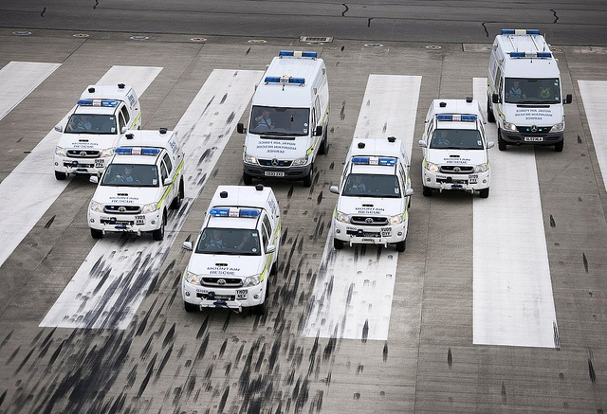
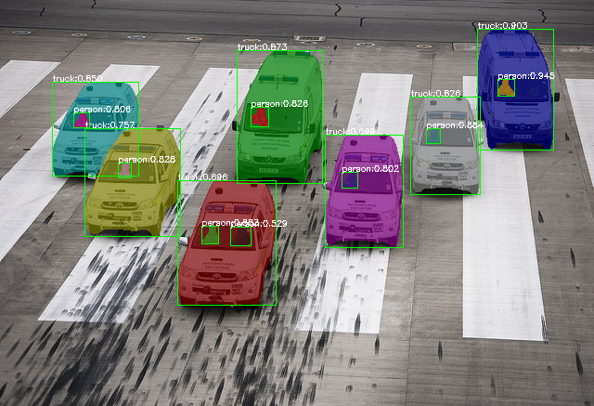
Visualization

Slide 40
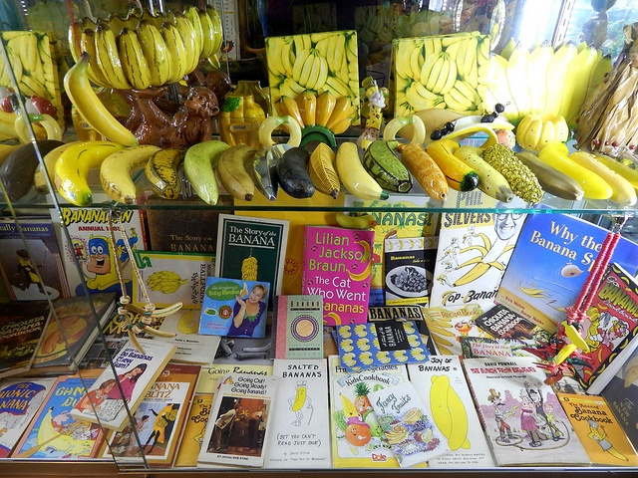
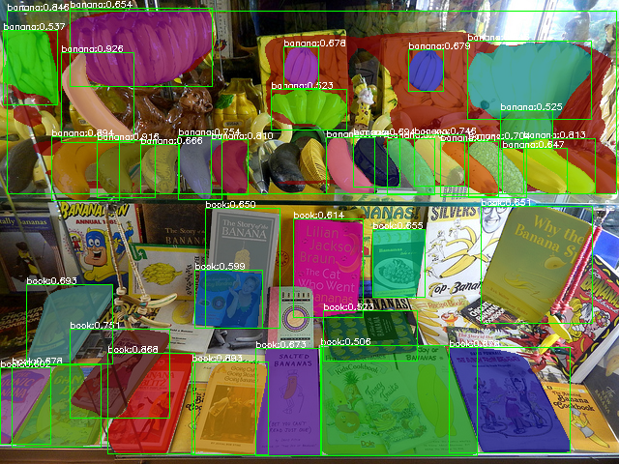
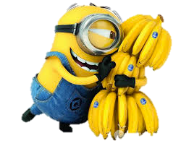
Visualization

Slide 41
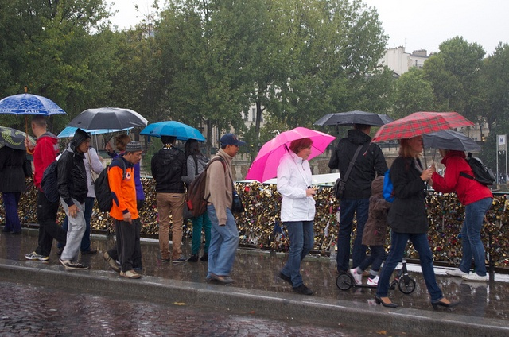
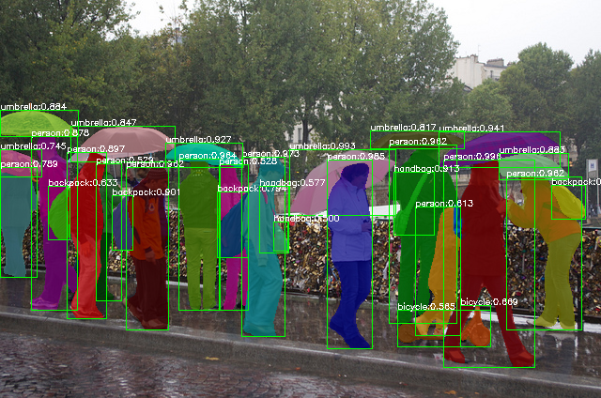
Visualization

Slide 42
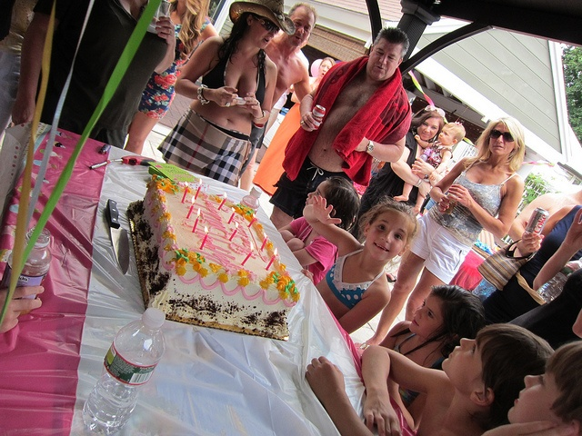
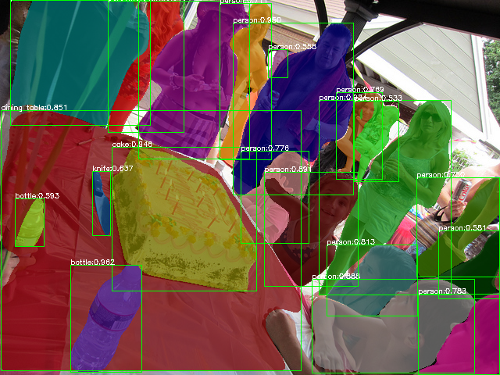
Visualization

Slide 43

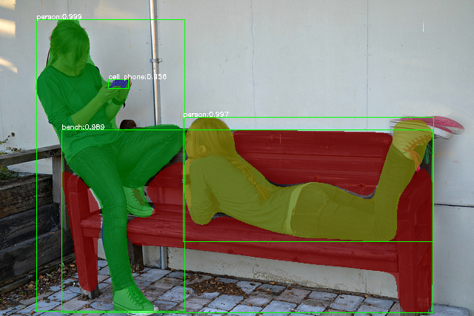
Visualization

Slide 44
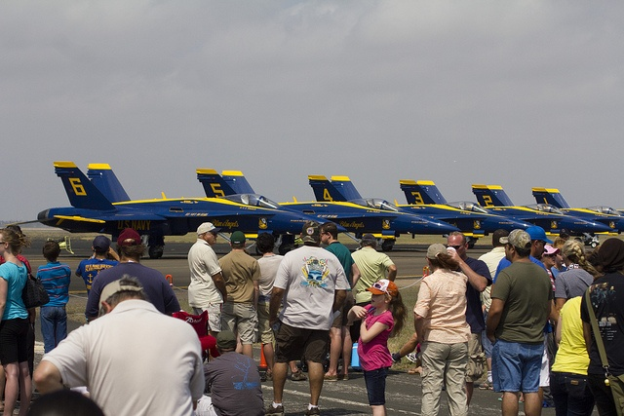
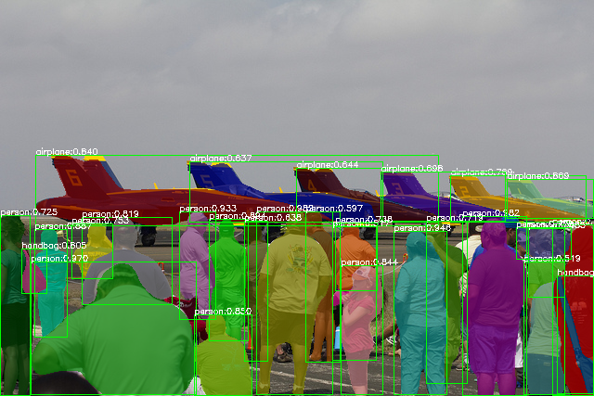
Visualization

Slide 45
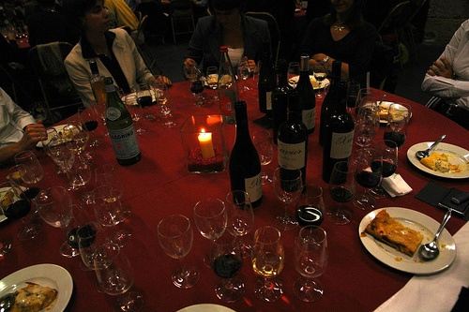
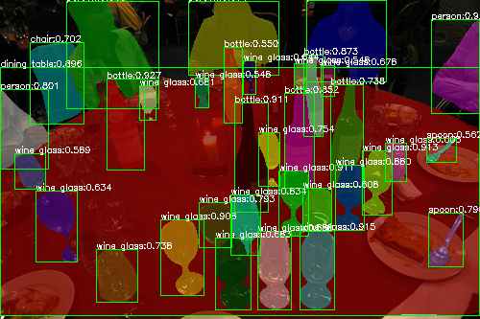
Visualization

Slide 46
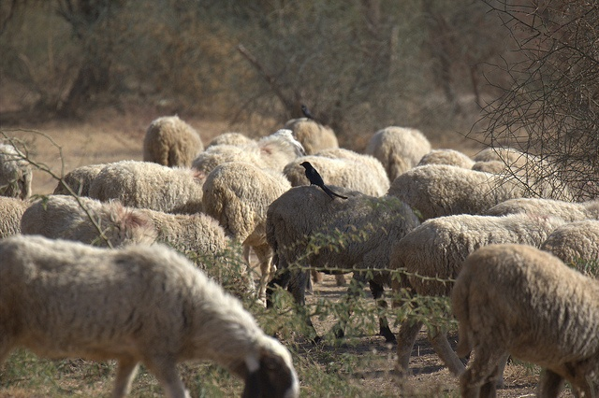
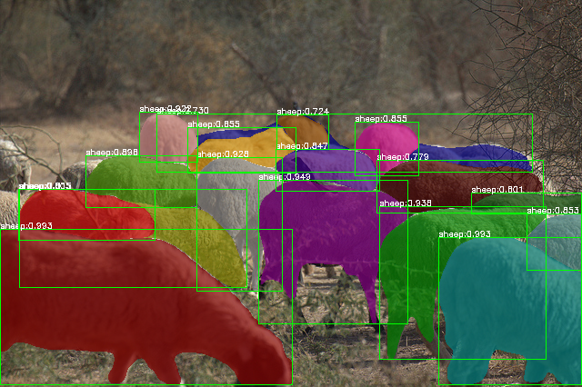
Visualization

Slide 47
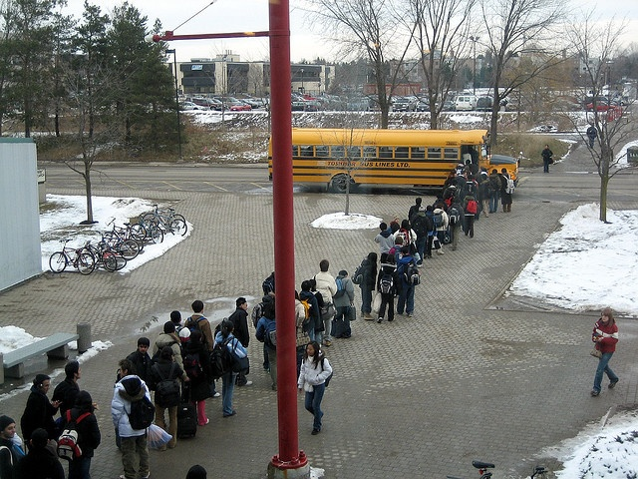
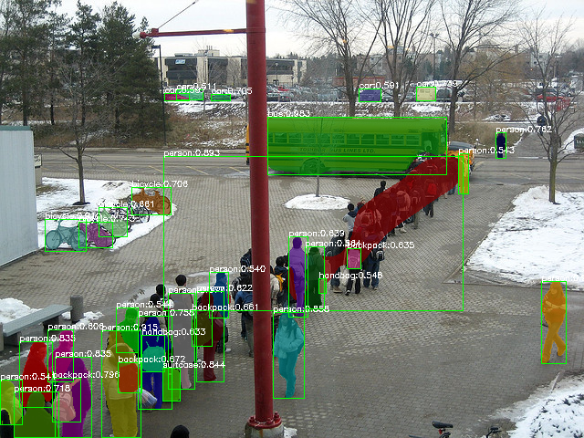
Visualization

Slide 48
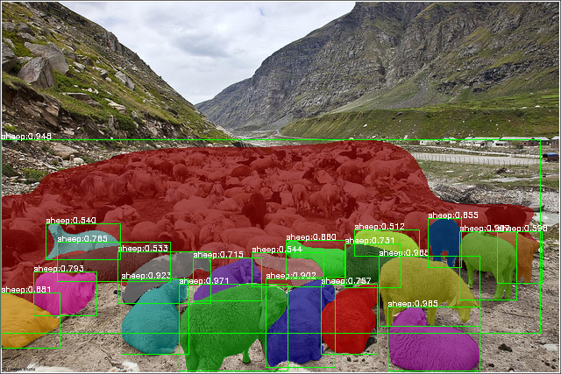
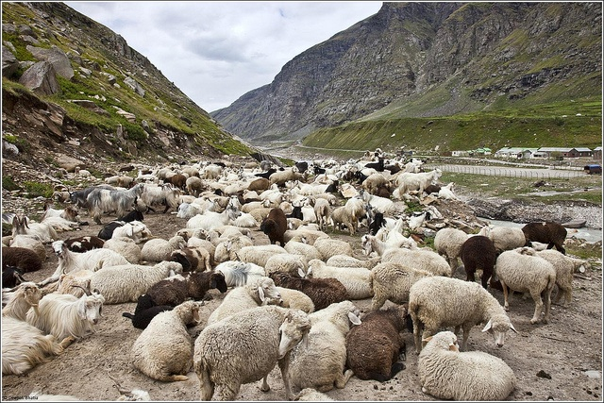
Visualization

Slide 49
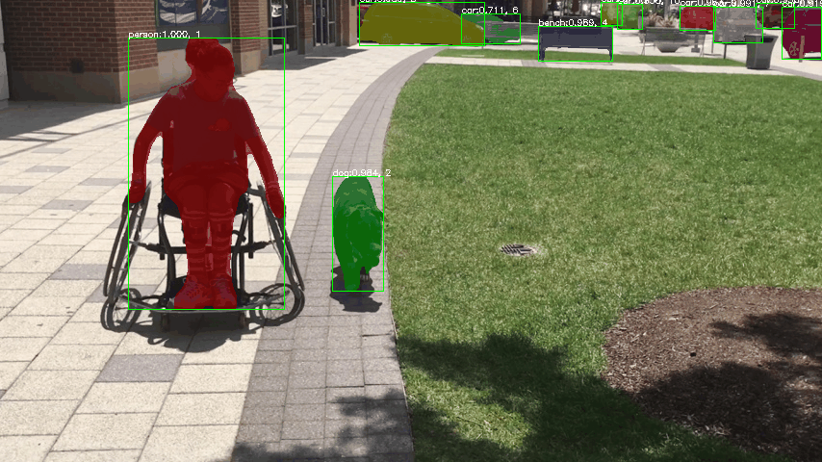
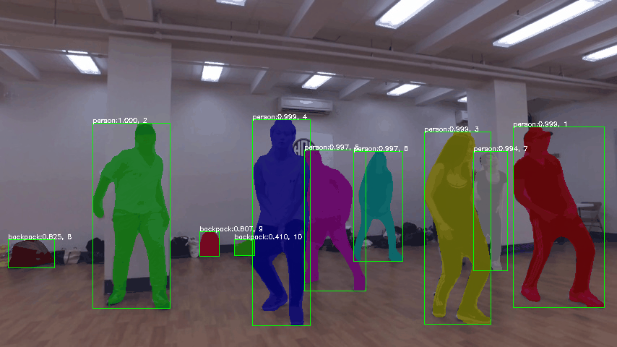

Slide 50
Thanks! Questions?
Code and trained models will be released!
More details will be described in technical report!

